Slide 1
FACE MASK DETECTION AND CLASSIFICATION USING CNN
(MobileNetV2)

Slide 2
INTRODUCTION
Objective: Detect and classify face mask types using deep learning.
Classes: No Mask, Surgical, Cloth, N95, N95 With Valve.
Model: MobileNetV2 used for efficiency and accuracy.
R

Slide 3

DATASET PREPARATION
Data loaded from directory with class-wise folders.
Images resized to 224x224 and preprocessed
Labels encoded and converted to categorical format.

Slide 4
DATA SPLITTING
Data split into 70% train, 15% validation, and 15% test.
Stratified splitting ensures class distribution balance.
Preprocessing applied using MobileNetV2 standards.

Slide 5
DATA AUGMENTATION
Techniques: Rotation, zoom, width/height shift, flip.
Used to improve generalization of the model.
Implemented via KerasImageDataGenerator.

Slide 6
MODEL ARCHITECTURE
Base: MobileNetV2 with pre-trained ImageNet weights.
GlobalAveragePooling+ Dense layer with softmax.
Frozen base layers initially, then fine-tuned last 30 layers.

Slide 7
TRAINING STRATEGY
First phase: Train with frozen base model (10 epochs).
Second phase: Unfreeze last 30 layers, fine-tune (10 epochs).
Optimizer: Adam with different learning rates.

Slide 8
EVALUATION & METRICS
Accuracy on test set: ~86.17%
Evaluation tools: Accuracy, Loss, Confusion Matrix, Classification Report.
Saved model for future use and inference.
86%

Slide 9
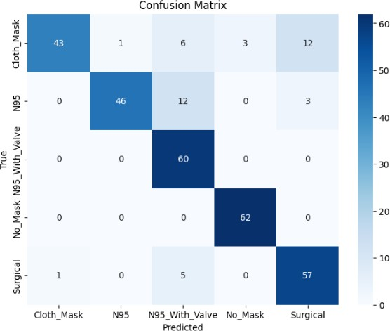
PREDICTIONS & VISUALIZATION
Random image predictions displayed with true/predicted labels.
Training vs Validation curves for loss & accuracy.
Confusion matrix and class-wise report generated.

Slide 10
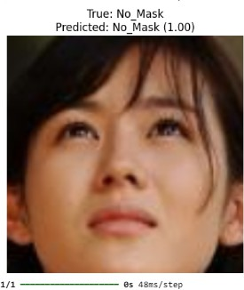
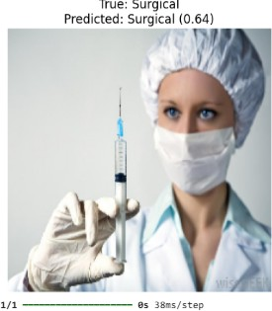
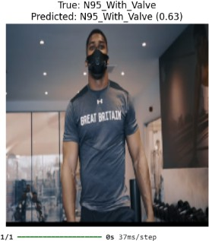
PREDICTIONS & VISUALIZATION

Slide 11
CONCLUSION
MobileNetV2 effectively detects mask types. Good generalization with data augmentation and fine-tuning.
Can be deployed in real-time systems for public safety.

Slide 12
THANK YOU

